Slide 1


Supply Chain Innovation
Jake Barr
Procter & Gamble
Karen Sambogna
Microsoft

Slide 2
Objectives
Overview of Industry “Supply Chain opportunity”
Background of P&G Supply Chain direction
Example of how we are stepping out of the box to attack one focus area within our vision
Q&A

Slide 3
External Factors
Wall Street expectations:
Cost (Labor)
Cash (Inventory)
Infrastructure – Legacy operations
**Attempting to change ahead of
capability

Slide 4
Supply Chain Opportunity -OOS
Average 8.3% total store*
Size varies across the globe (5-30%)
Worth 3-4% of $ sales - total store*
Worth 11% of $ sales of top 2,000 items
Sale item out of stocks usually double everyday outs
* 45+ Industry studies and internal research to support

Slide 5
What are the causes?
60-80% store related
3% warehouse/supplier related
~15% supply issues:
  Product not on shelf but in the store
Product out at store but available from DC
Product out at DC but available from Mfg.
Product out at DC and out at Mfg.
Balance are HQ and alignment issues
Split - demand based, operationally based
80% of OOS last longer than 24 hours

Slide 6
How do shoppers react?
At the category level average 25%-67% of out of stocks turn into lost sales
At the brand level “switching” can run up to 98% - not all brands’ out of stocks are the same!
.5% of customers cite out of stocks as the reason they switch stores

Slide 7
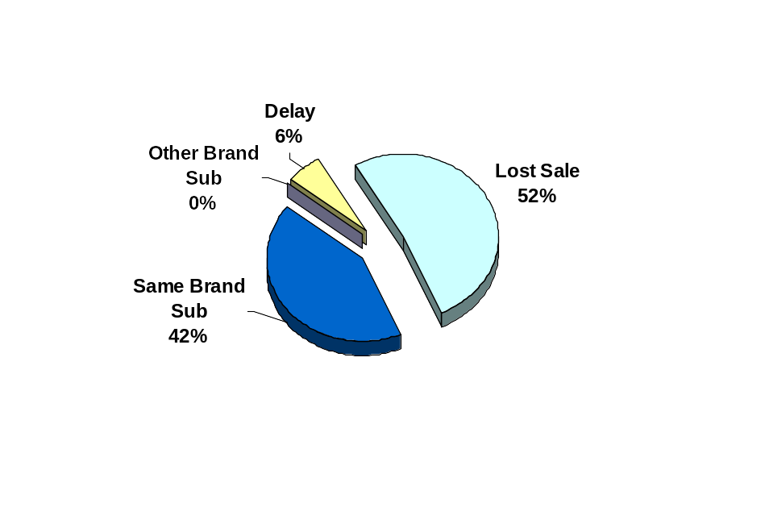
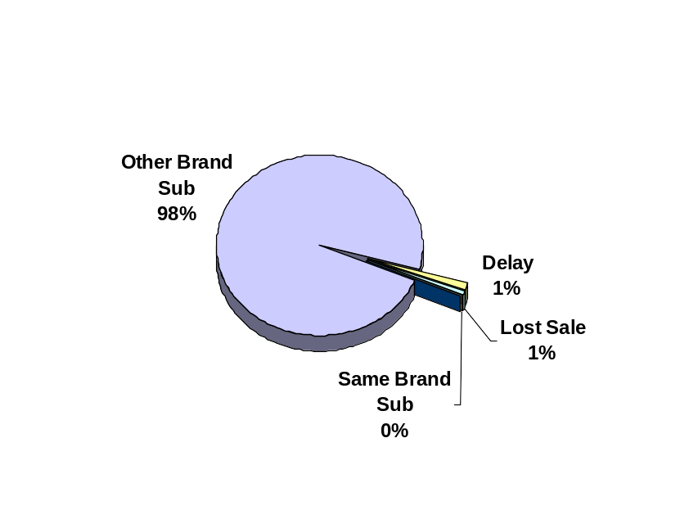
What do consumers do when confronted with an Out-of-Stock?
Example: Tide vs. “X” Detergent
Tide
Surf
Consumers of Brand “X” just substitute another brand when Brand “X” is OOS.
Half of Tide sales are lost during a Tide OOS, and the rest go to a substitute Tide item or delayed purchase.
Page 7

Slide 8
Supply Chain Direction
Create a demand driven supply chain, which leverages near real time information flow for end to end integration of the supply chain partners
The vision is about connecting what is needed in the Supply Chain
with what is possible…

Slide 9
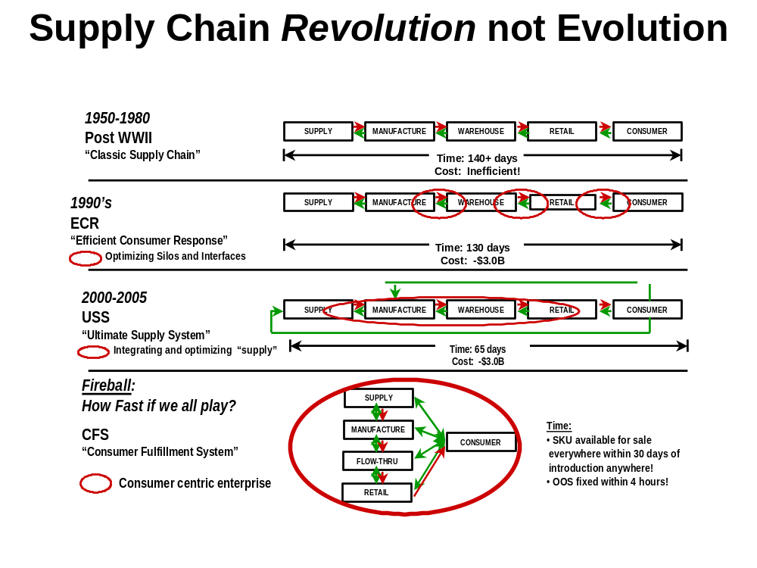

Slide 10
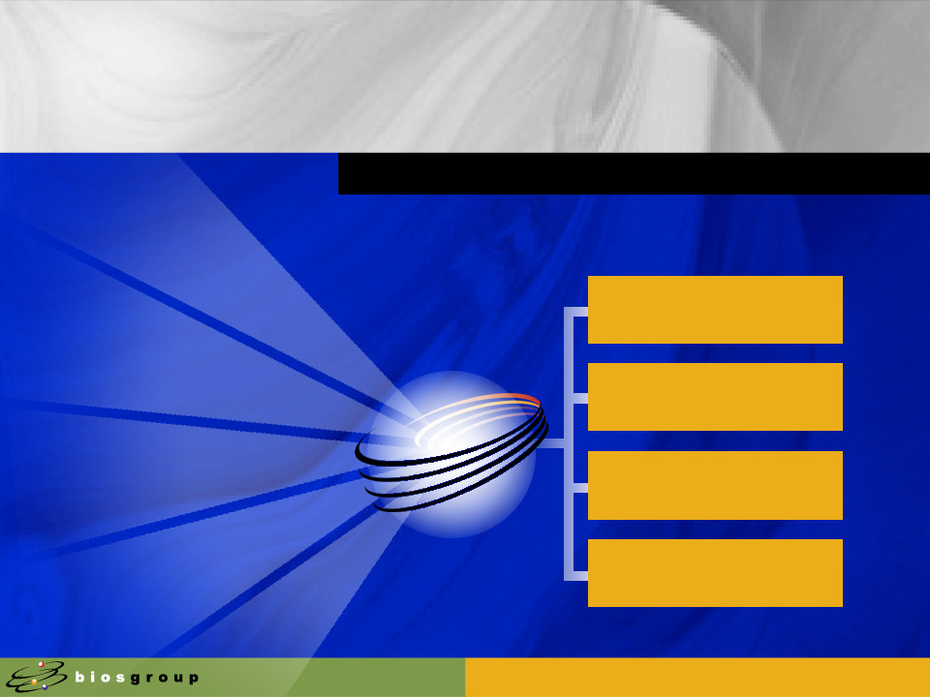

Fireball
What are the key components
Future Supply Chain
Characteristics
How do we address…
Speed Demand Signal
Acquisition
Short replenishment
Cycles – Defined as:
“Consumer purchase to replacement”
Intelligent Replenishment
24/7 distribution of stores - “the only Inventory is moving”
Demand based planning
Supply Chain is a “Network” –
“You don’t own all the components”
Deployment network

Slide 11
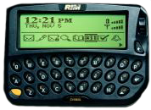
Report date & time
Item Description
The Consumer Demand Signal
OOS 02/23/2001 15:49
O 004151132001 123456 P
ROMAN MEAL ROUND TOP BREAD
Wireless Pagers, PDAs
Summary Reports Current state of the Store
Periodic Reports What’s changed
Promotional Status
O = Out of Stock
F = Too Fast
S = Too Slow
Item Code
UPC Code

Slide 12

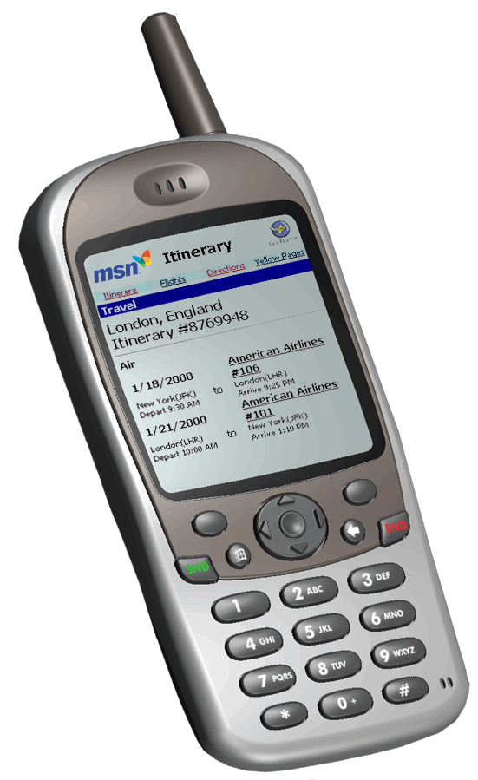

Suppliers
BizTalk Server
A
P
P
L
I
C
A
T
I
O
N
S
Repl
Plan
E
N
T
E
R
P
R
I
S
E
Alloc
A
D
A
P
T
E
R
S
CRM
P
O
S
Transform
Orchestrate
Route
SA
Merch
LP
Fin
Rpt
DSS
Services
Notification
Devices

Slide 13

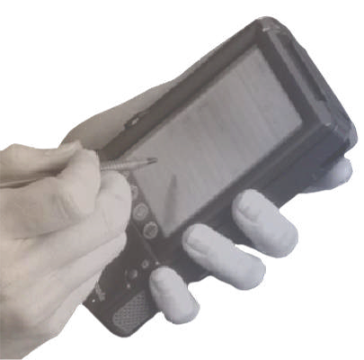
The Result:
Business Agility for Retailers
Key Considerations
Solution Sell with Compelling ROI
Deliver real business value
Flexible, Affordable Technology Foundation
Support EAI, BI Solutions, and B2B Channel Collaboration on a .Net platform
Enterprise Level Execution
Not another box in the store

Slide 14
Questions?

